Slide 1
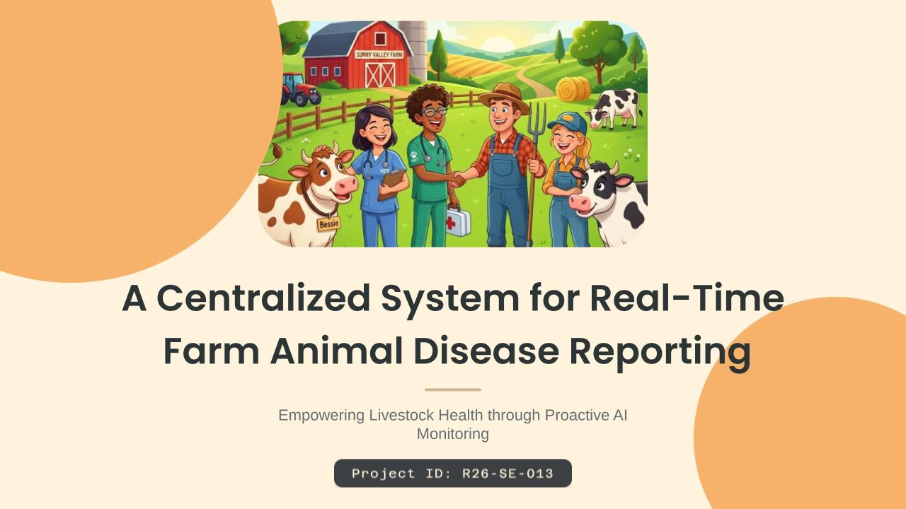

Slide 2


GitHub Repo Link : https://github.com/lasitha-dev/R26-SE-013.git
Prototype Link : https://stitch.withgoogle.com/preview/10377423638356891694?node-id=8eb394c036aa47019448ff5f60ebe072

Slide 3
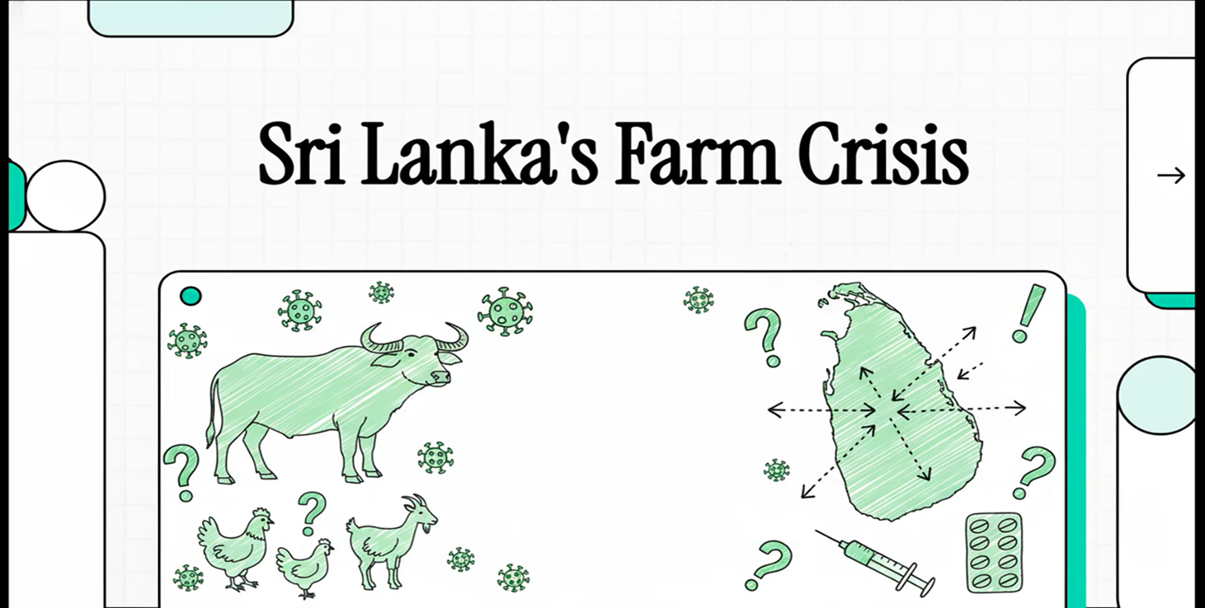
2 Minute Introduction Video

Slide 4
Panel feedback & research adaptations
Panel Comments | Solution Used
No GPA tracked Farm Location in Sri Lanka | Adopted Thailand Livestock geospatial datasets are substitute, justified by Thailand's climatic similarity to Sri Lanka.
Limited GPS-level outbreak data in Sri Lanka (Insufficient data to train a reliable regression model for disease spread prediction) | Replaced sole reliance on ML models with a Physics-Inspired Environmental Vector Field (EVF) model, adopted on panel recommendation to compensate for sparse data.
Different diseases spread via different environmental and seasonal factors. ( A single set of prediction parameters cannot apply uniformly across diseases ) | Developing disease-specific forecasting models with separate environmental, climate, and outbreak parameters per disease to improve accuracy and seasonal reliability.

Slide 5
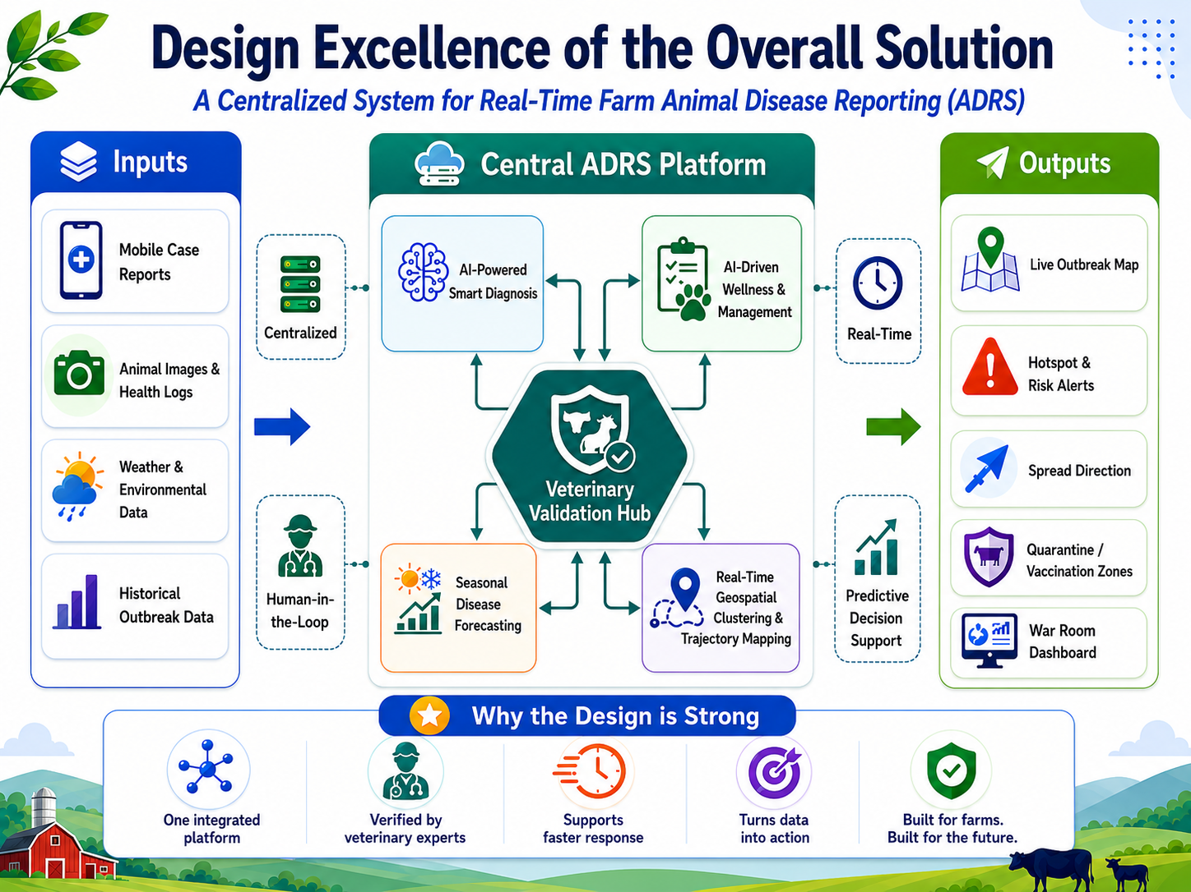
A Centralized System for Real-Time Farm Animal Disease Reporting
Problem & Impact
Current disease reporting is manual, slow, and fragmented.
Diseases like FMD and LSD can spread before action is taken.
Farmers face income loss due to reduced milk/meat production and animal deaths.
Delayed response creates risks to national food security.
Target Users / Beneficiaries
Farmers – receive early warnings and support.
Field Veterinary Officers – get verified real-time outbreak data.
Government Animal Health Authorities – make faster control decisions.
Livestock Industry – reduces disease spread and economic loss.

Slide 6

IT21129544 | A.L.M Athulathmudali
AI Smart Diagnosis
Specialization: Software Engineering

Slide 7
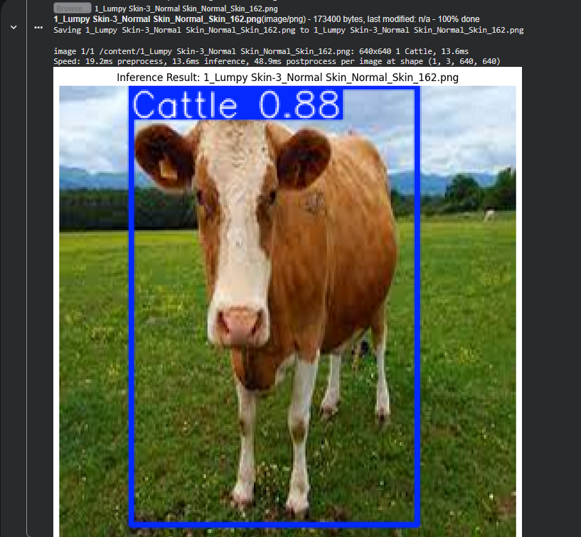
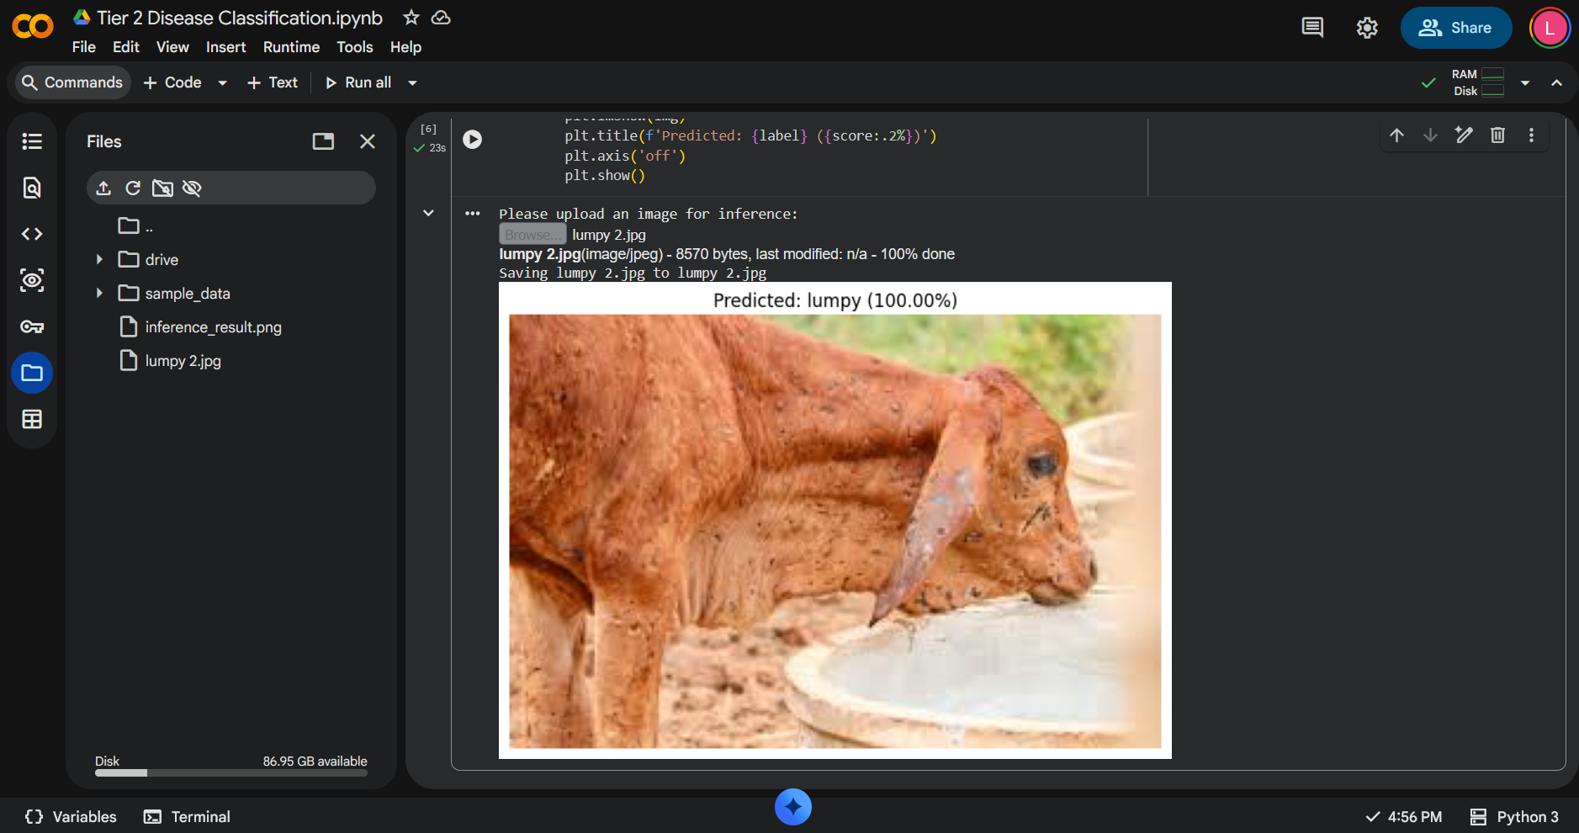
Evidence-Based Diagnosis (Tiered Model)
Addressing the Sub Problem
Robust Environmental Isolation: YOLOv8 instantly crops cattle from complex farm backgrounds to eliminate visual noise.
High-Confidence Classification: Vision Transformers analyze biological textures to identify diseases (e.g., Lumpy Skin) with over 88% accuracy.
Addressing User Requirements
Intelligent Input Filtering: A YOLOv8 gate automatically rejects invalid backgrounds so diagnostics only process real cattle.
Autonomous Diagnosis: An integrated Swin Transformer accurately classifies specific symptoms for expert-level field triage.
IT21129544 | A.L.M Athulathmudali | R26-SE-013​
​

Slide 8
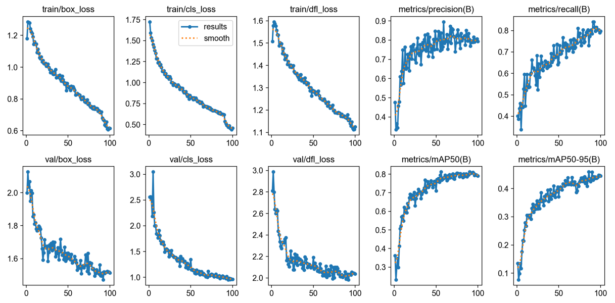
Excellence & Validation
Empirical Validation: Training metrics demonstrate healthy convergence without overfitting, achieving a stable 81% mAP that validates the model's reliability for real-world field triage.
User Feedback on Prototype
High Clinical Trust: Stakeholders highlighted the visual evidence and confidence scores as crucial for trusting the AI's diagnosis.
IT21129544 | A.L.M Athulathmudali | R26-SE-013​
​

Slide 9

IT22194558 | W.M.P.J Wijenayake
AI-Driven Wellness and Management Standardization
Specialization: Software Engineering

Slide 10
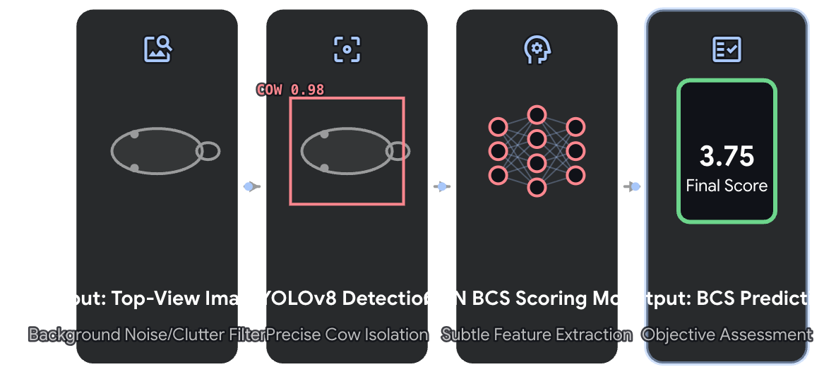
How the Solution Addresses the Sub-Problem & User Requirements
How the Solution will address the Sub-Problem / Prototype:
Two-Stage AI Pipeline: Developed an integrated pipeline using YOLOv8 and CNN models to eliminate background noise
Precision Auto-Cropping: Utilizes YOLOv8 to accurately detect the cow's body (Region of Interest) and automatically crop it, ensuring the regression model only processes relevant data.
Accurate BCS Regression: Employs a robust CNN model to analyze the cleaned, cropped image and calculate a highly accurate Body Condition Score (BCS), capturing subtle features that the human eye might miss.
User Requirements Addressed by the solution:
Scalable & Cloud-Ready: Lightweight architecture designed for seamless Mobile and Web integration.
Automated Experience: Zero-code, single-click scoring pipeline for non-technical users.
Non-Invasive Monitoring: Remote top-view assessment; zero physical stress or contact with animals.
IT22194558 | W.M.P.J Wijenayake | R26-SE-013​
​

Slide 11
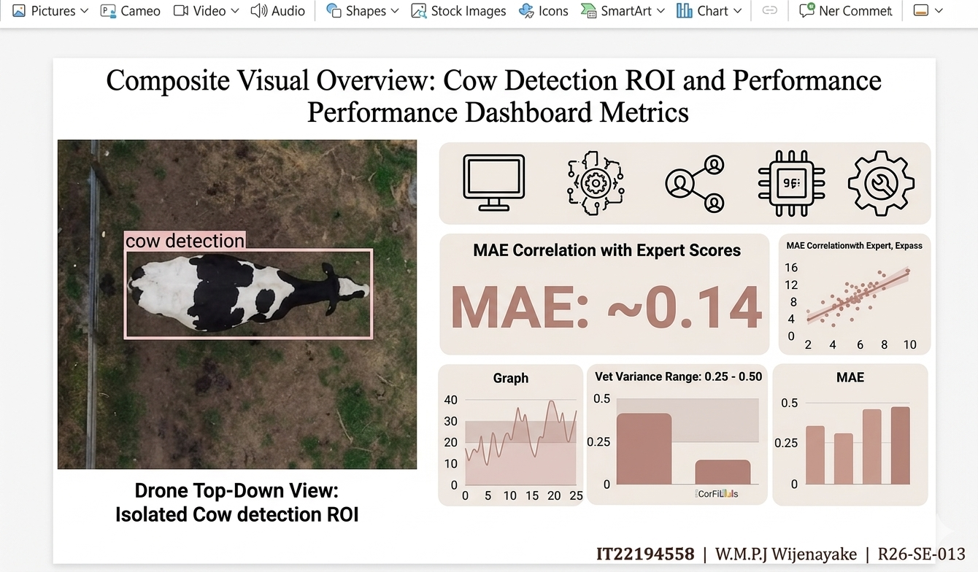
Design Excellence & Prototype Feedback
1. Design Excellence / Contribution:
High-Precision YOLOv8: Achieved 99.4% (mAP50) detection accuracy via 100-epoch training.
Dynamic Padding Algorithm: Custom 30-pixel margin logic to preserve critical anatomical edges.
Optimized CNN Architecture: Specialized regression model trained on real-world CoRFiLaC images.
2. Prototype Feedback (Validation)
Exceptional Accuracy: Achieved MAE of ~0.14, reaching near human-expert performance.
High-Speed Inference: Dual-model pipeline analysis completes in under 2 seconds.
Visual Trust & Validation: Transparent ROI display builds user confidence in automated scoring.
IT22194558 | W.M.P.J Wijenayake | R26-SE-013​​
​​
​

Slide 12

IT22221414 | Kumarasinghe S.S
Climate-Informed Livestock Disease Forecasting and Early Warning Module
Specialization: Software Engineering

Slide 13
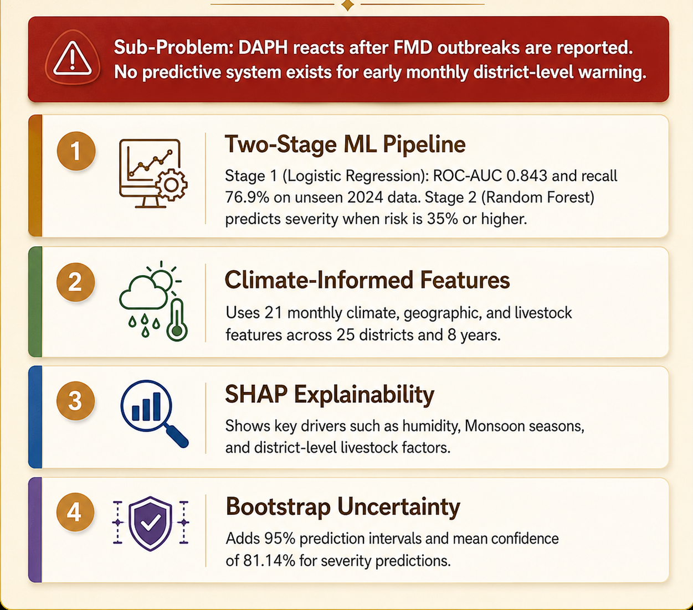
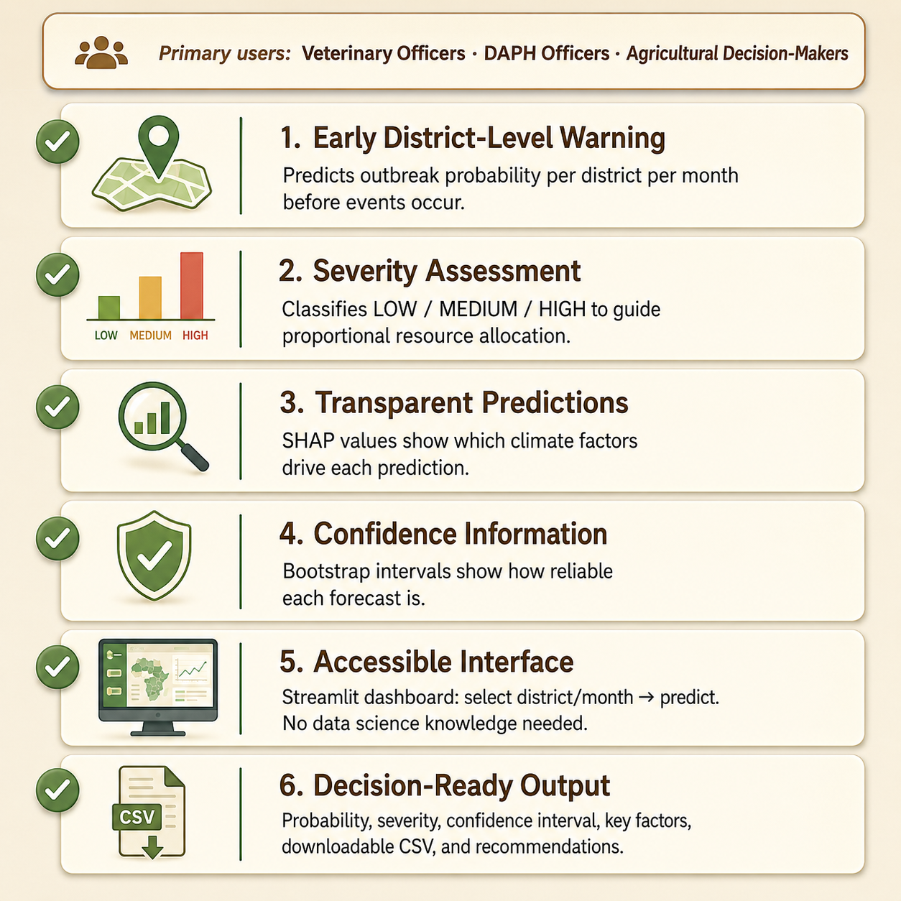
Solution & User Requirements
How the Solution Addresses the Sub-Problem
User Requirements Addressed
IT22221414 | Kumarasinghe S.S | R26-SE-013

Slide 14
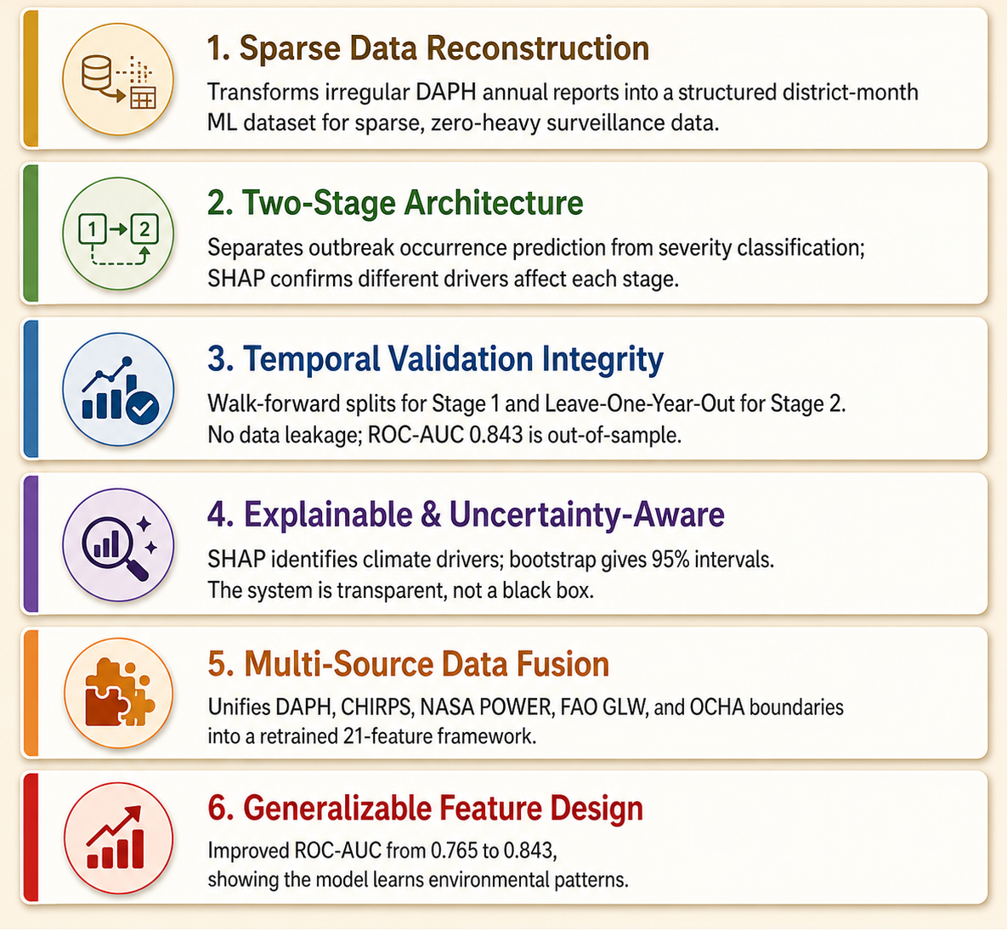
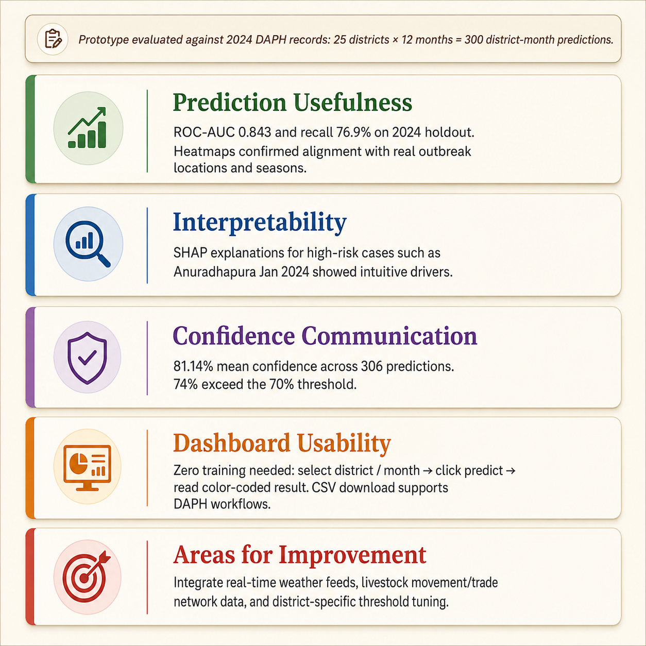
Design Excellence & User Feedback
Design Excellence / Contribution
User Feedback on Prototype
IT22221414 | Kumarasinghe S.S | R26-SE-013

Slide 15
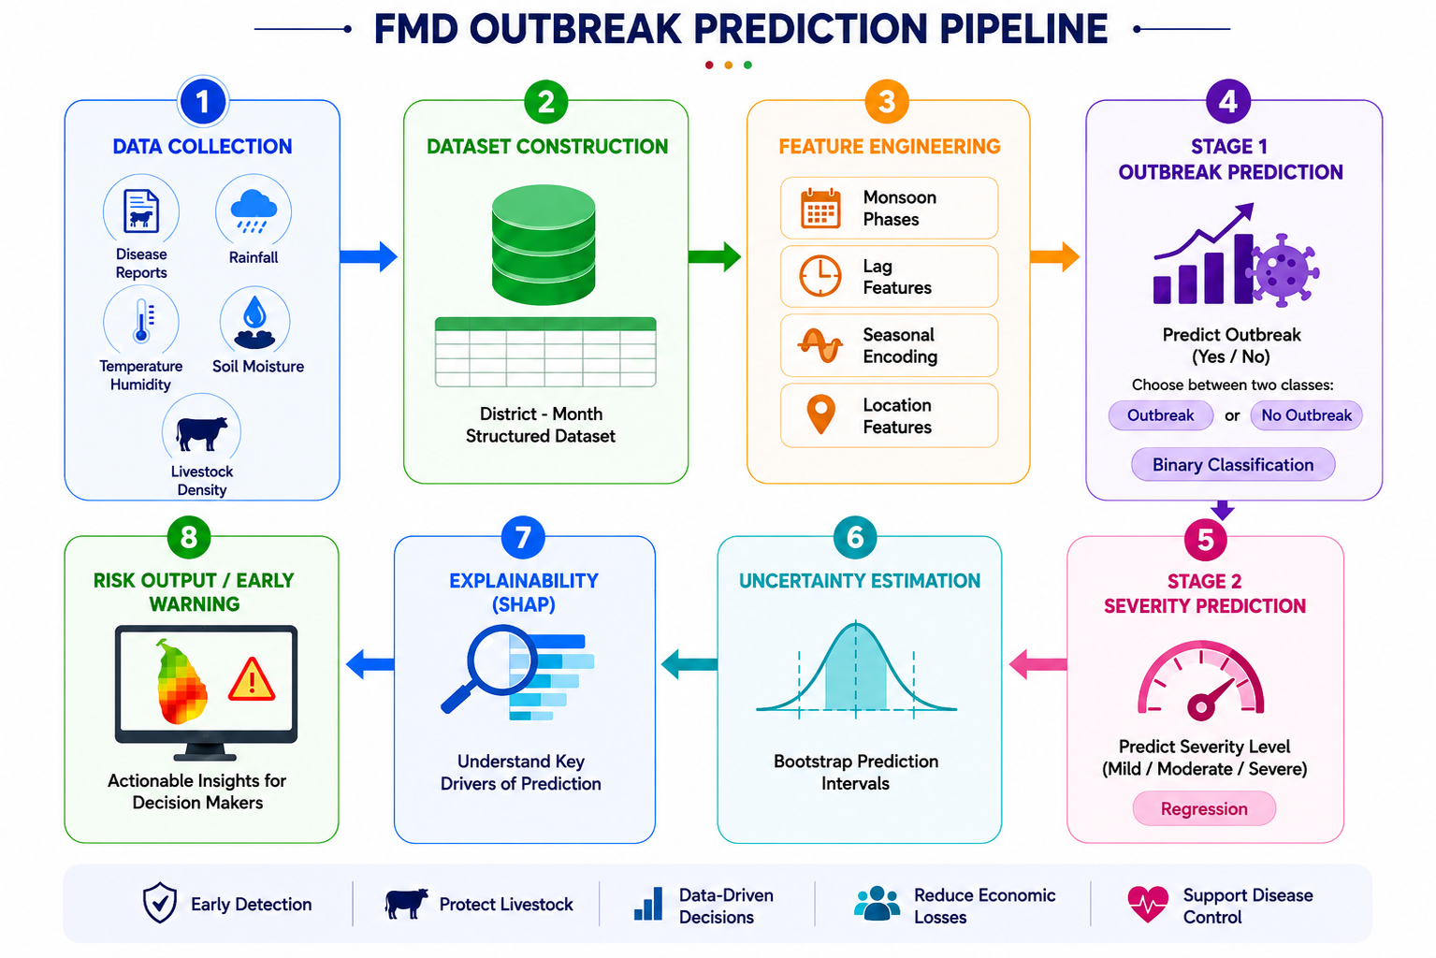
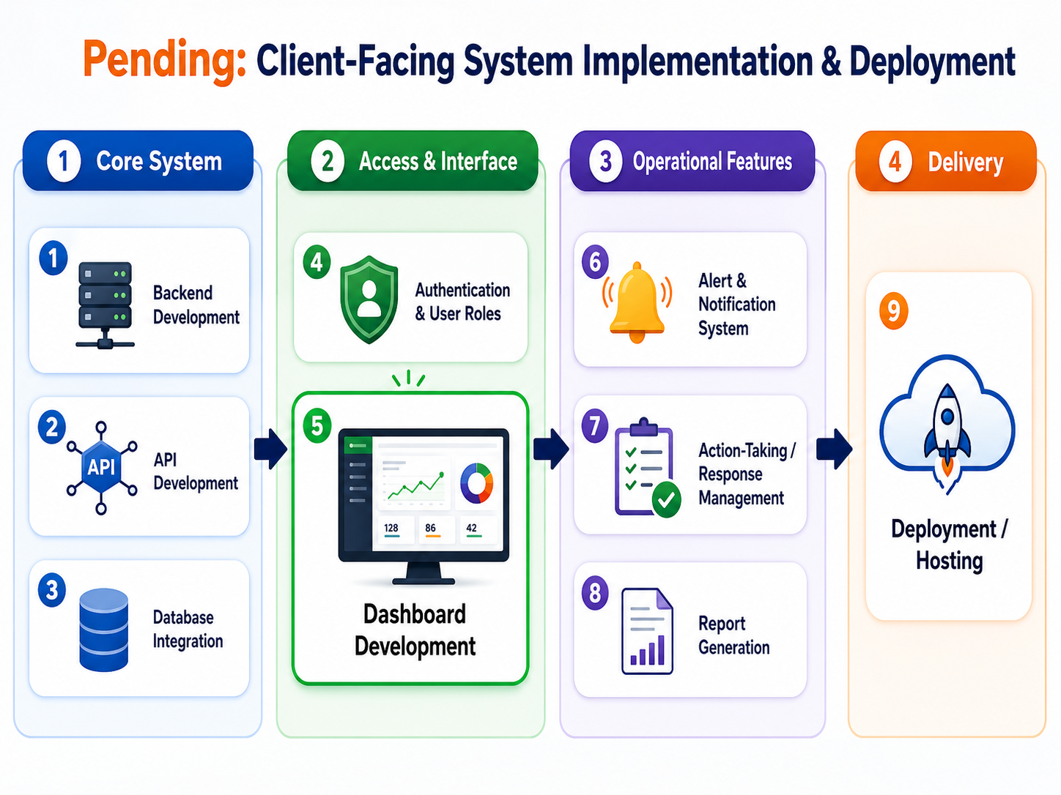
Progress : Climate-Informed Foot and Mouth Disease Forecasting and Early Warning Subcomponent.
Completed: Climate-Informed Predictive Analytics Pipeline
Pending: Client-Facing System Implementation
and Deployment
IT22221414 | Kumarasinghe S.S | R26-SE-013

Slide 16
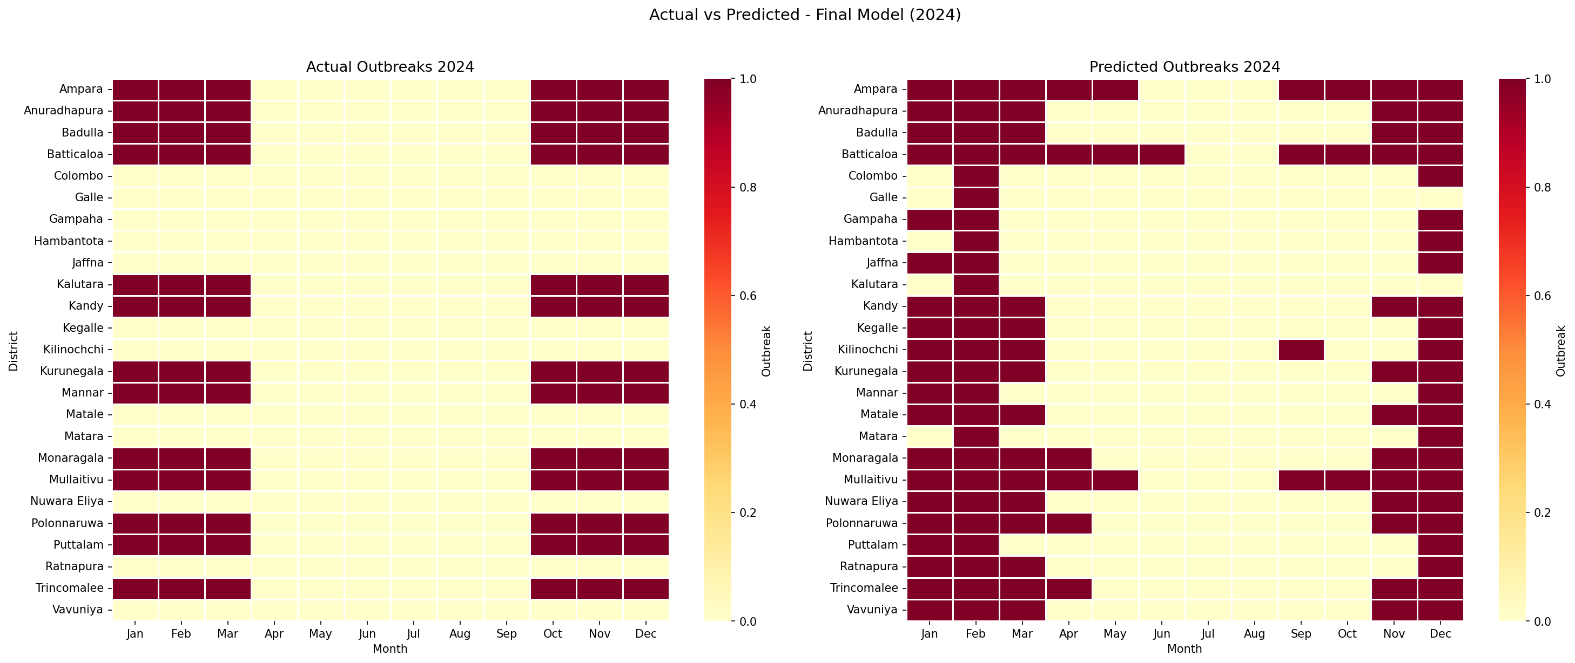
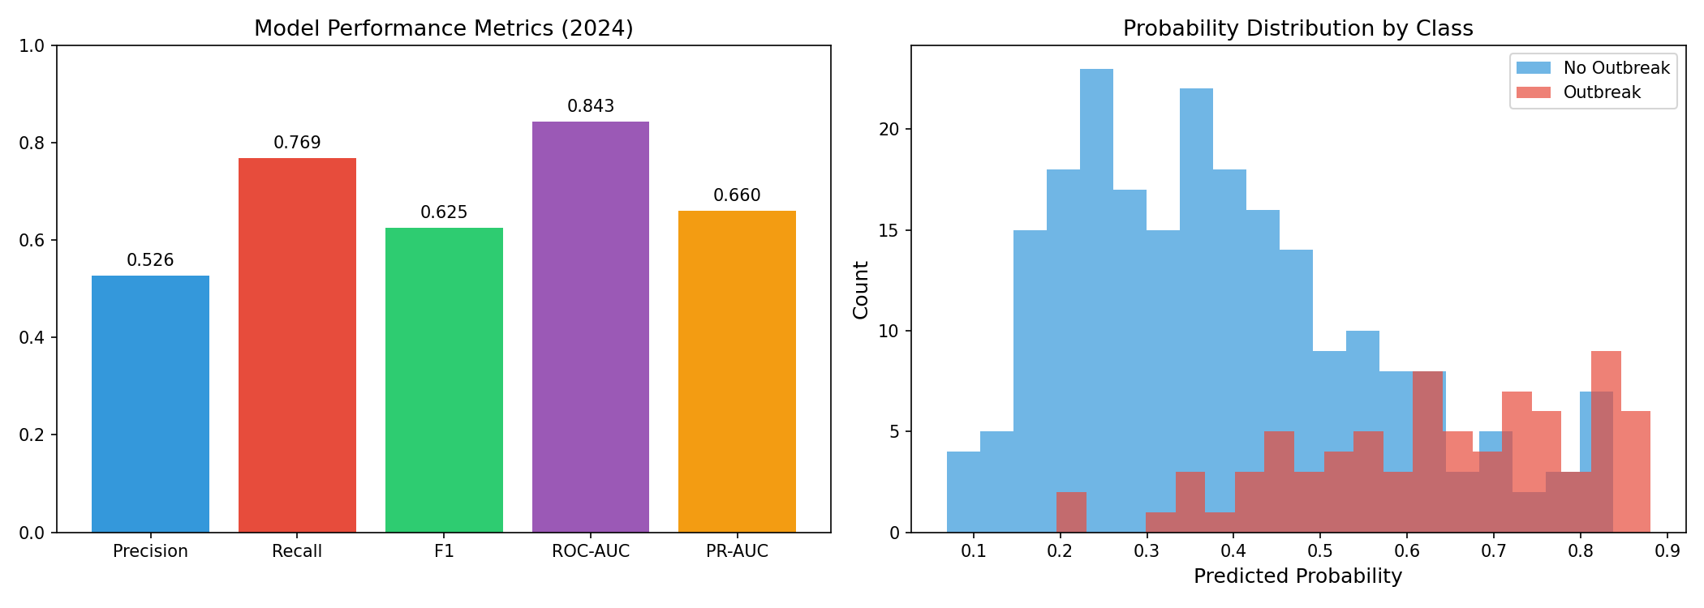
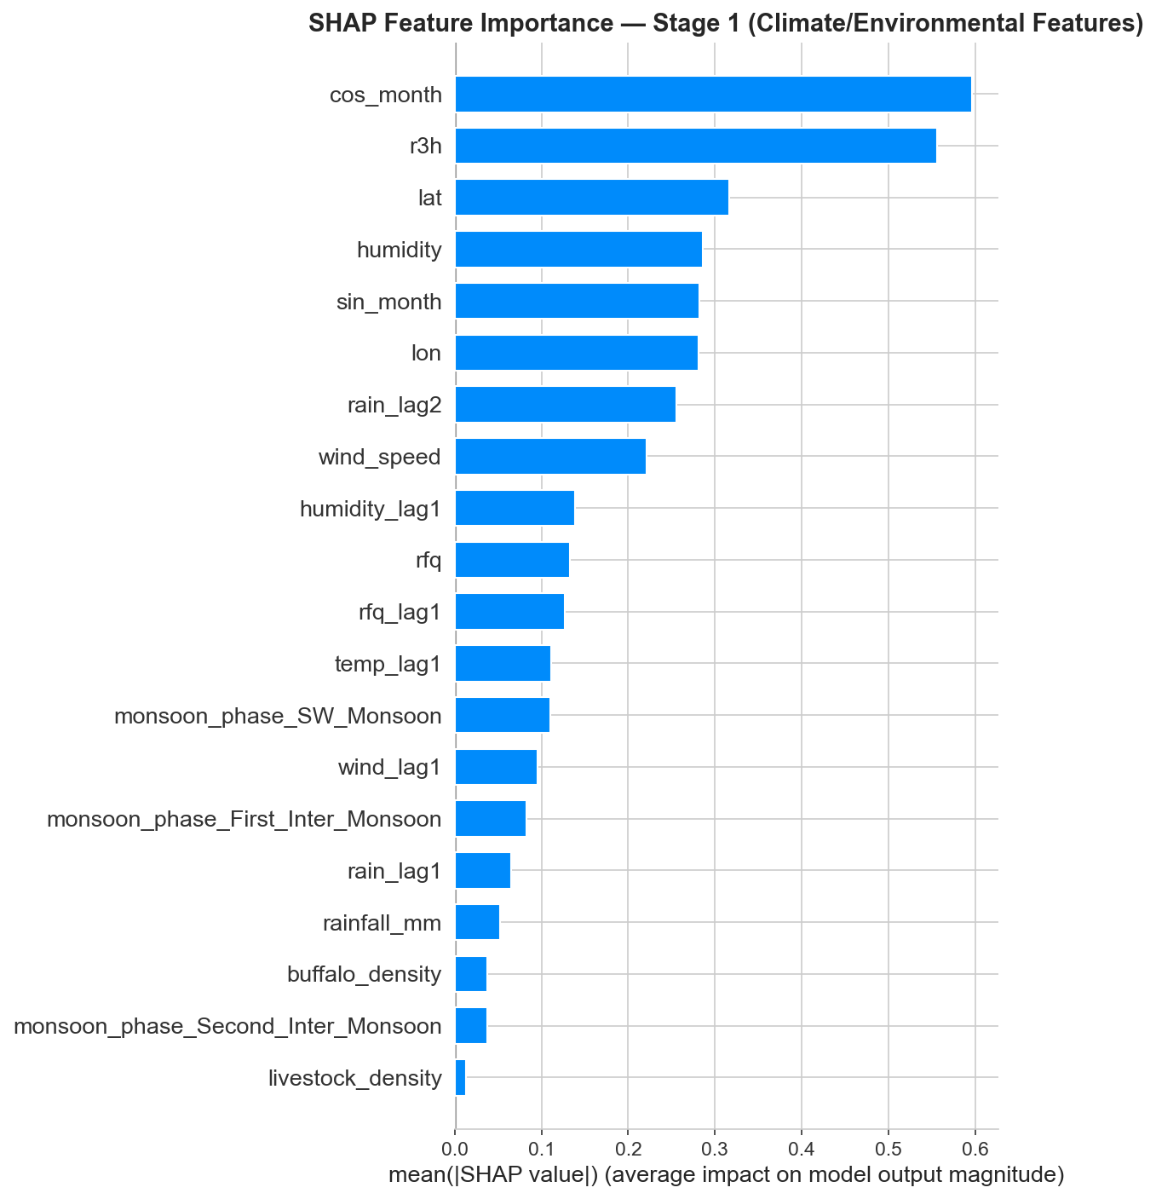
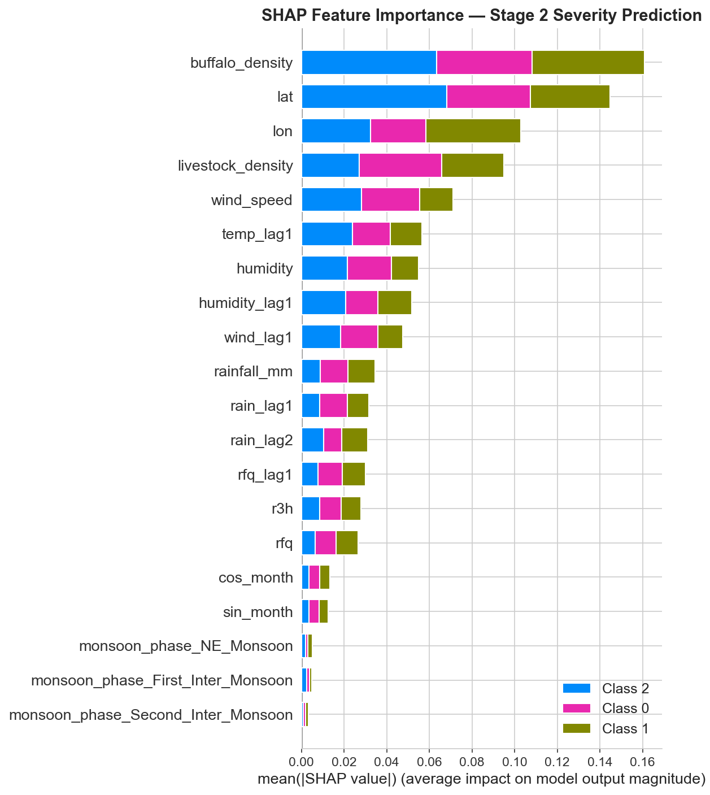
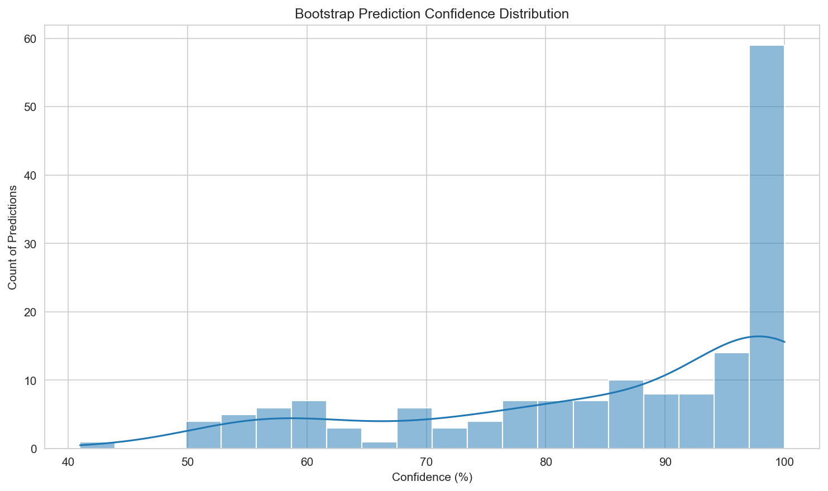
Fig 1: Actual vs Predicted Outbreaks for 2024.
The model correctly identifies the majority of outbreak locations and seasons using only climate and livestock features (ROC-AUC: 0.843)
Fig 2: Stage 1 Model Performance on unseen 2024 data.
76.9% recall ensures 3 out of 4 real outbreaks are detected before they occur
SHAP Feature Importance: Climate variables (humidity, rainfall) drive outbreak occurrence — the model learns generalizable environmental risk patterns, not district memorization
Stage 2 SHAP Analysis: Once an outbreak starts, livestock density determines severity — validating the epidemiological principle that environment determines IF, population determines HOW BAD
Bootstrap Uncertainty: 81% mean prediction confidence — enabling risk-based decision making for veterinary resource allocation
IT22221414 | Kumarasinghe S.S | R26-SE-013

Slide 17

IT22258908 | Sandaru G.A
Real-Time Geospatial Visualization Intelligence Map
Specialization: Software Engineering

Slide 18
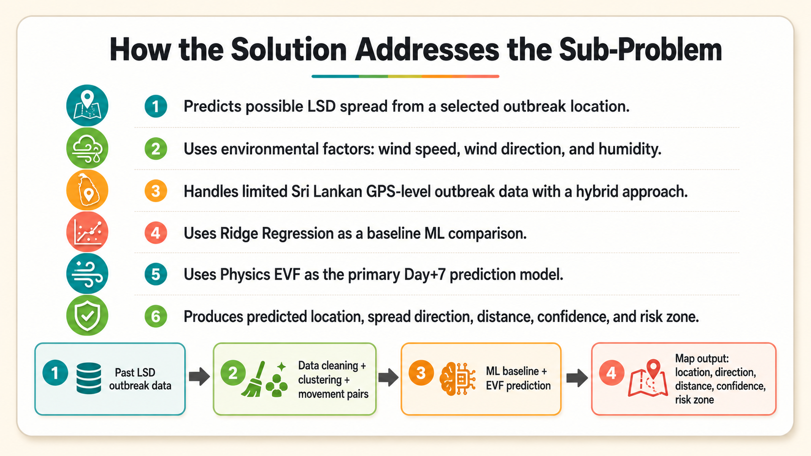
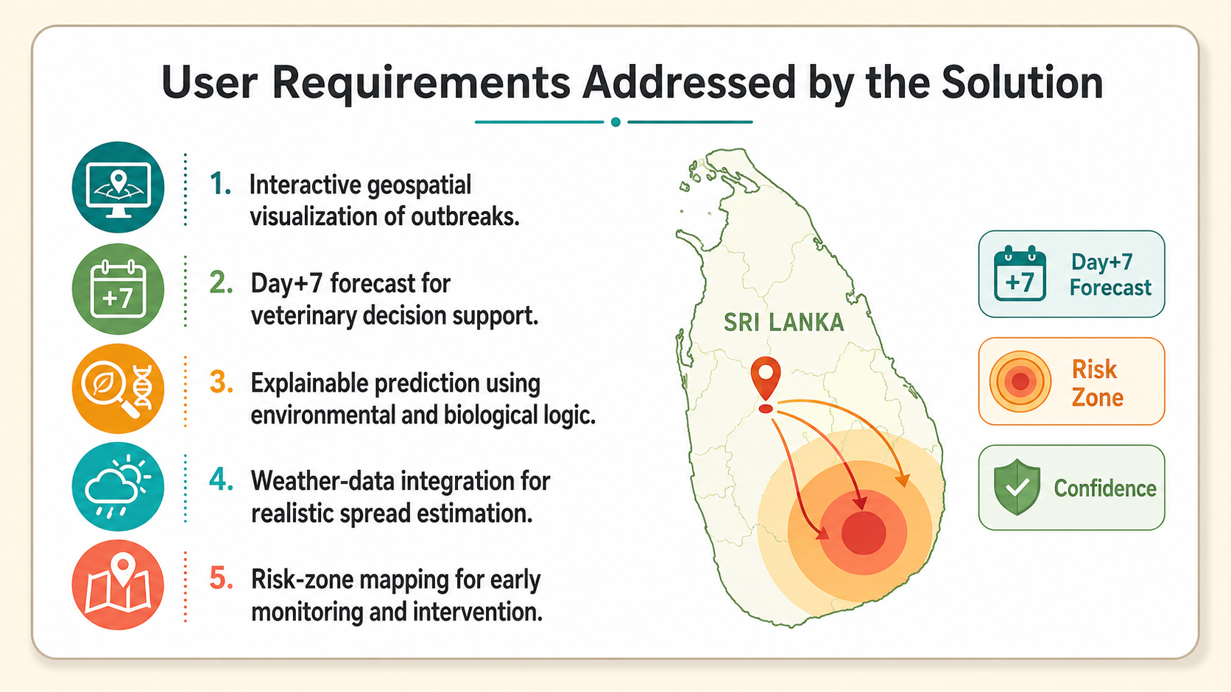
Solution & User Requirements
IT22258908 | Sandaru G A | R26-SE-013

Slide 19
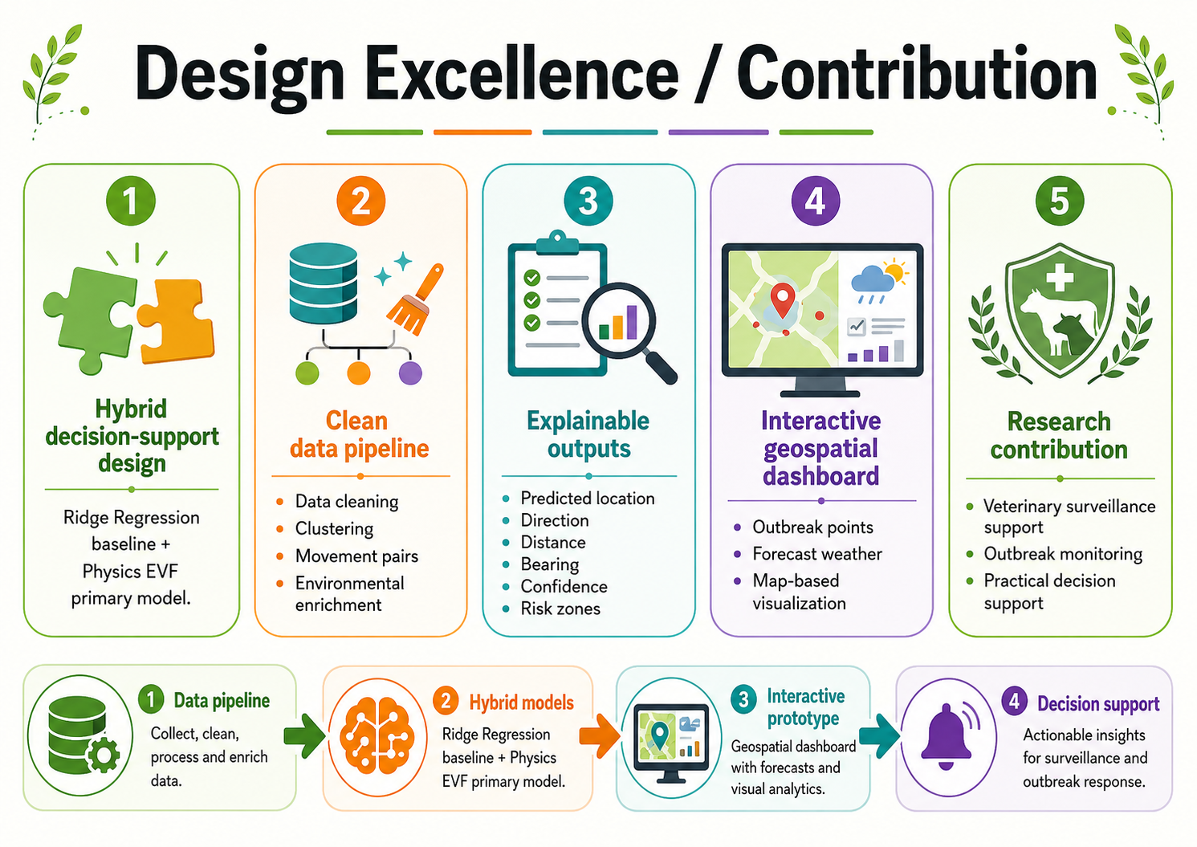
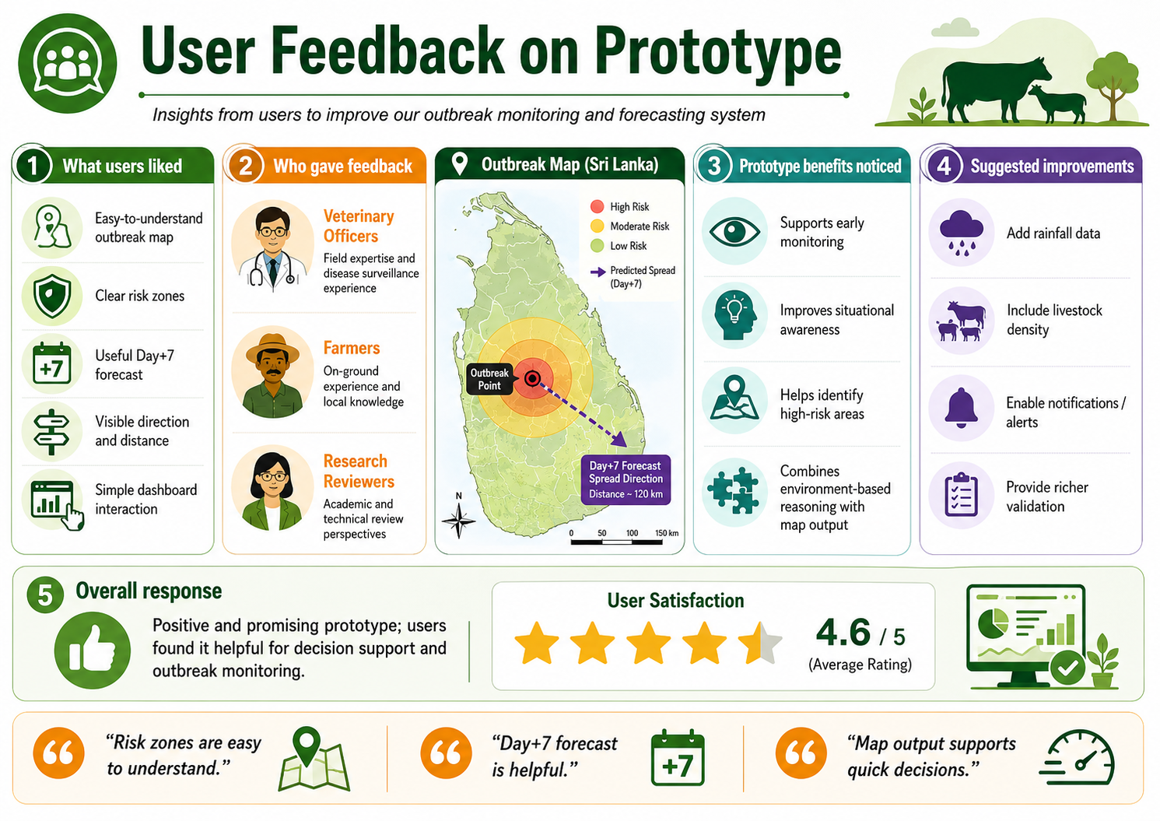
Design Excellence & User Feedback
IT22258908 | Sandaru G A | R26-SE-013

Slide 20
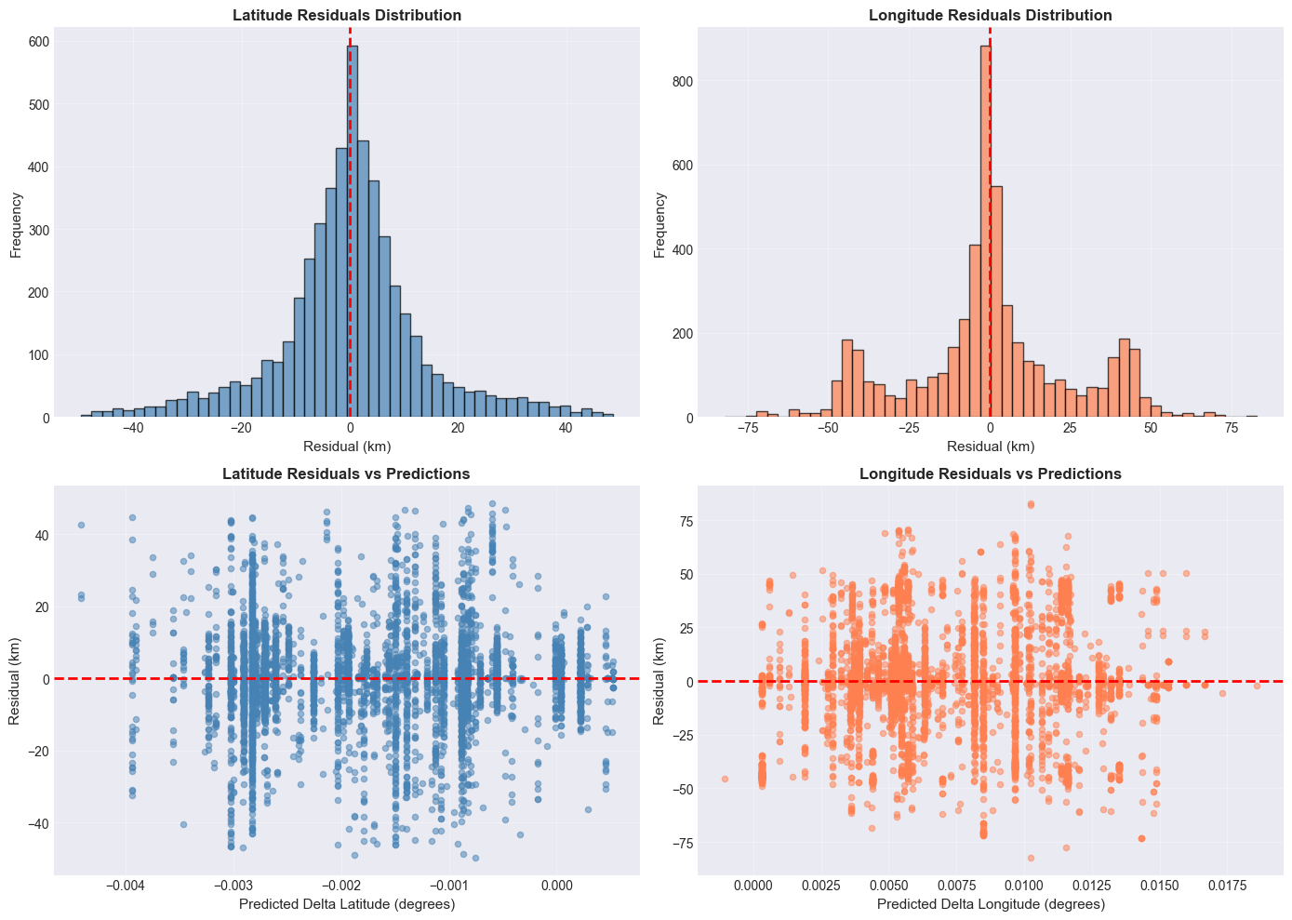
ML Model Error Analysis
Physics EVF Validation
Past outbreaks are used to test the model under real historical conditions.
Historical weather data is applied to generate EVF-based risk zones.
Validation is done using risk-zone hit rate, direction matching, and distance error.
This helps prove whether the EVF model can realistically predict future livestock disease spread.
Residuals show prediction error; wider errors prove wind and humidity alone are not enough, so ML is used only as a baseline.
IT22258908 | Sandaru G A | R26-SE-013

Slide 21
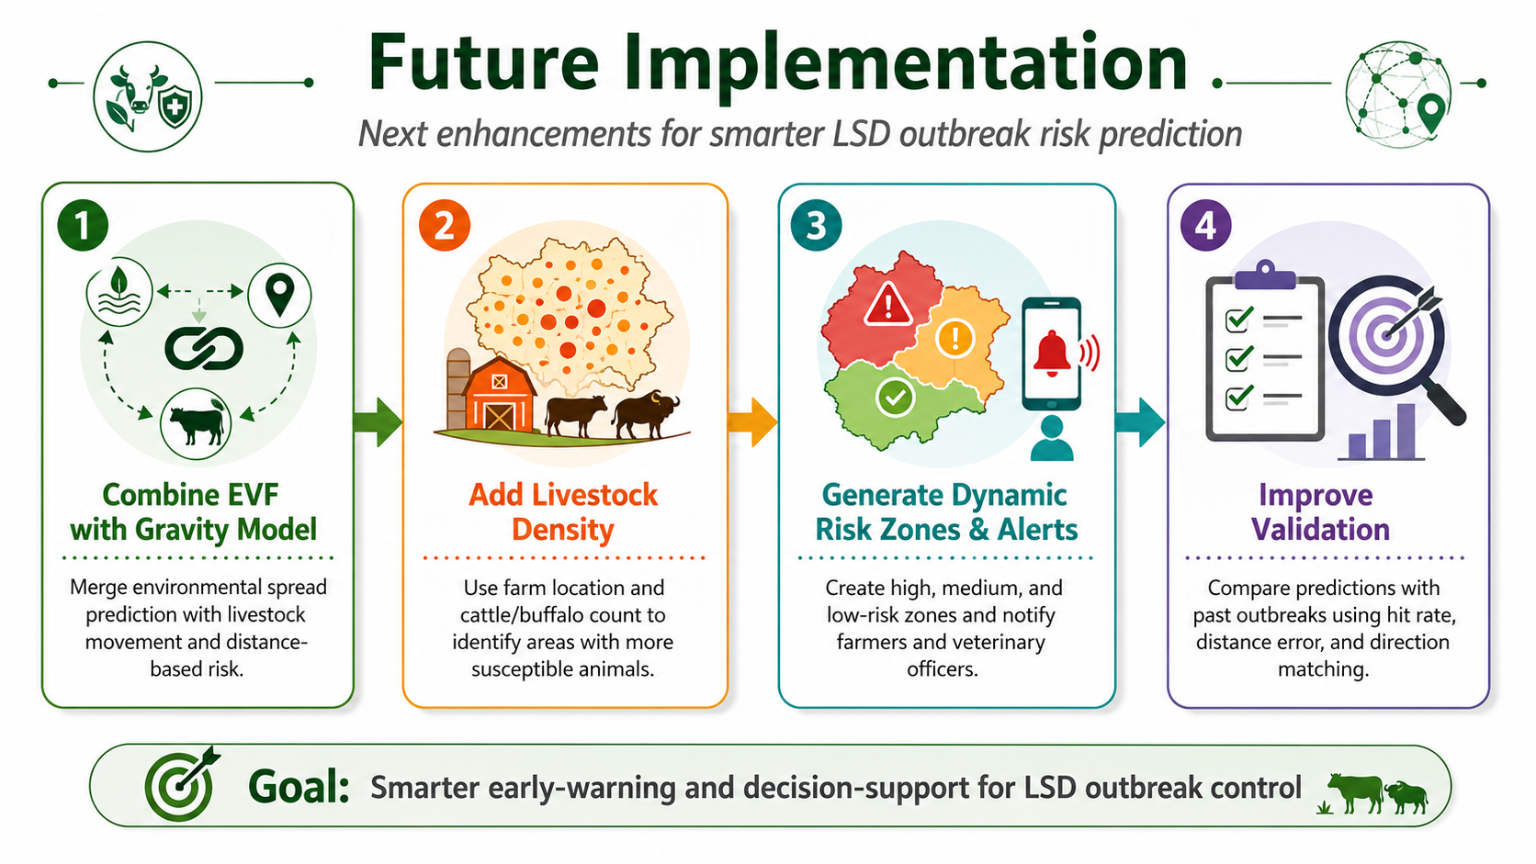
Future Implementation
Combine EVF with Gravity Model — Improve the current EVF prediction by adding livestock movement and distance-based risk between farms or regions.
Add Livestock Density — Use farmer registration data such as farm location and cattle/buffalo count to identify high-risk areas with more susceptible animals.
Generate Dynamic Risk Zones & Alerts — Create high, medium, and low-risk zones based on prediction results, then send alerts to farmers and veterinary officers.
Improve Validation — Compare predictions with past outbreak records using risk-zone hit rate, distance error, and direction matching.
IT22258908 | Sandaru G A | R26-SE-013

Slide 22
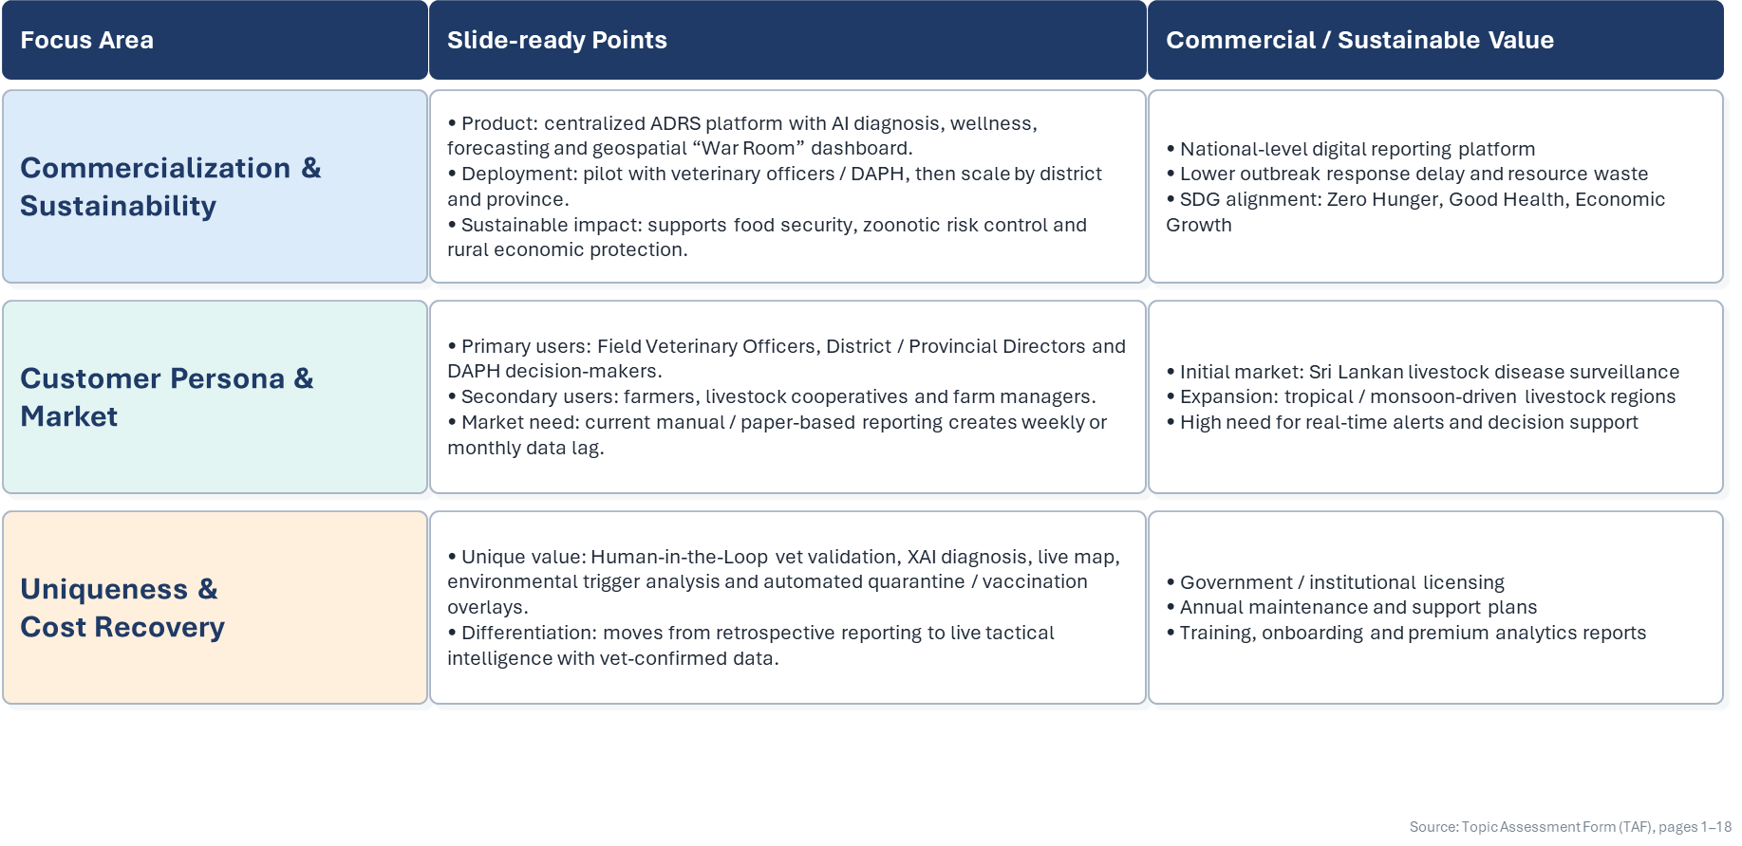
Commercialization, Sustainability & Market Value

Slide 23
Thank You!

